Slide 1
Regular Expressions
Practice

Slide 2
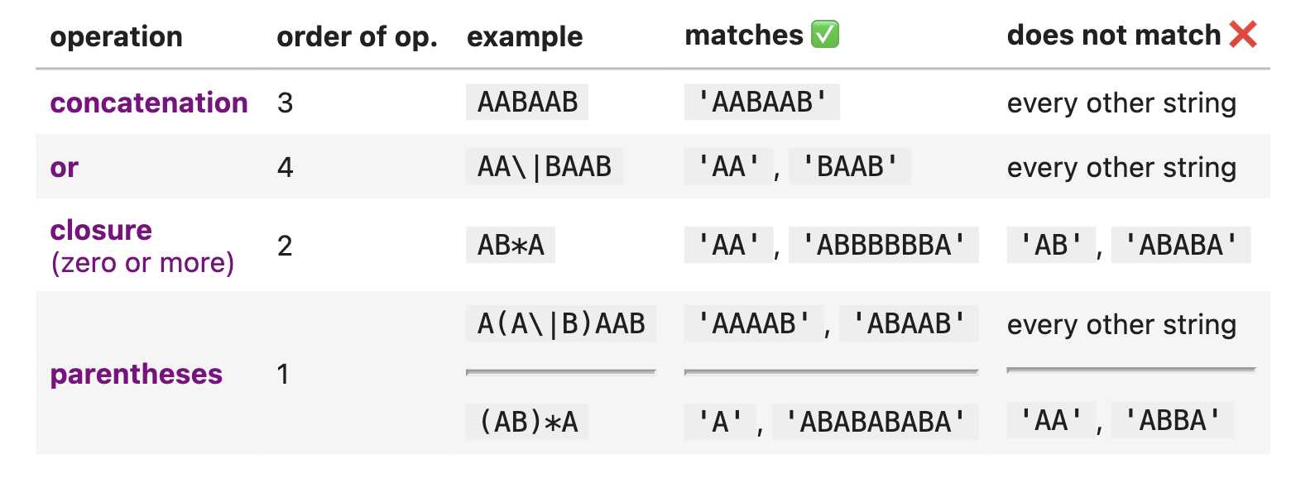
Fundamental Building Blocks

Slide 3
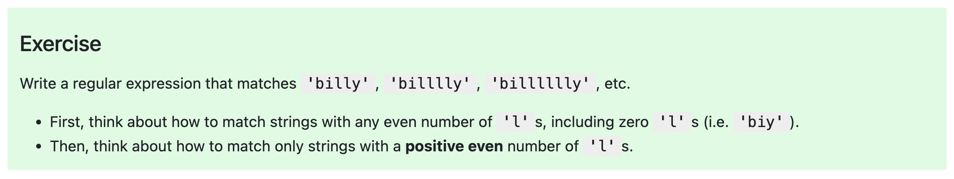
Try It! ☺

Slide 4
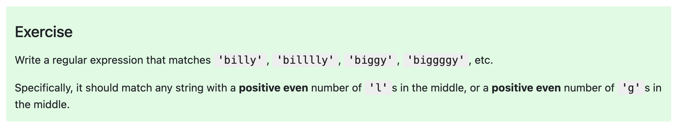
Try It! ☺

Slide 5
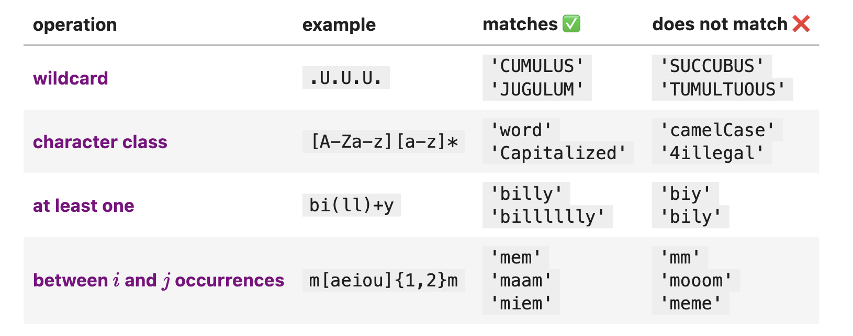
Intermediate RegEx
Example (character classes, at least one): [A-E]+ is just shortform for (A|B|C|D|E)(A|B|C|D|E)*.

Slide 6
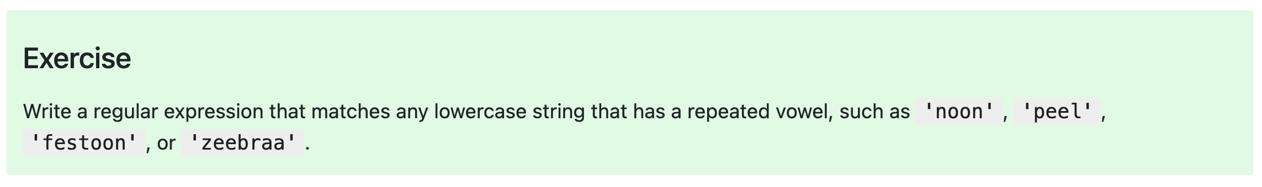
Try It! :)

Slide 7
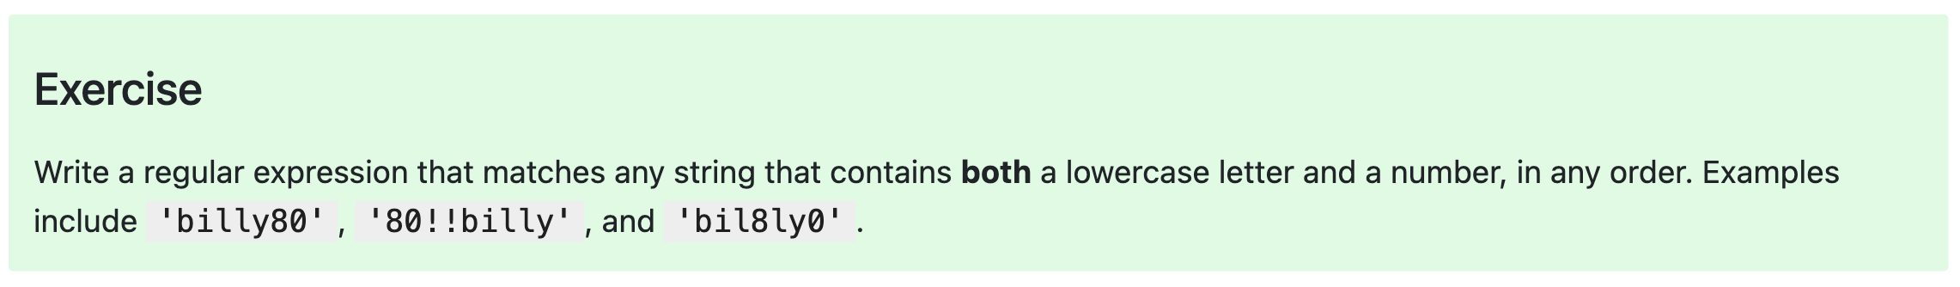
Try It! ☺

Slide 8
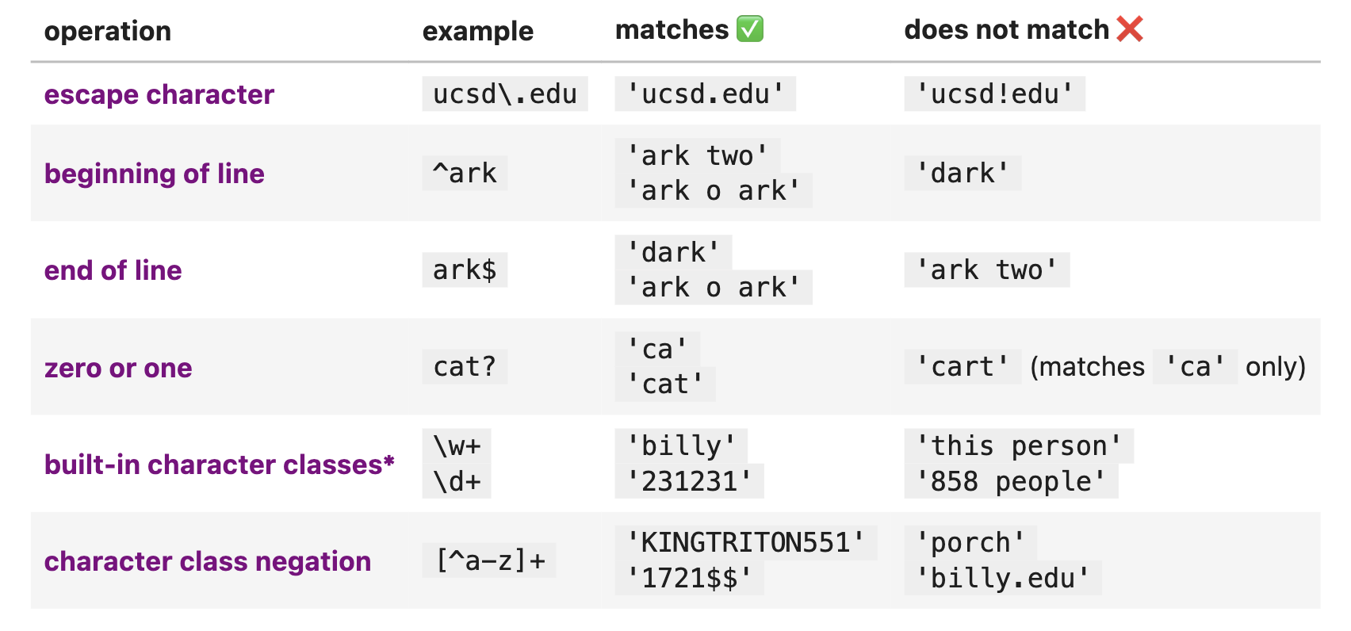
More RegEx!
\d refers to digits.
\w refers to alphanumeric characters ([A-Z][a-z][0-9]_).
\s refers to whitespace.
\b is a word boundary.

Slide 9
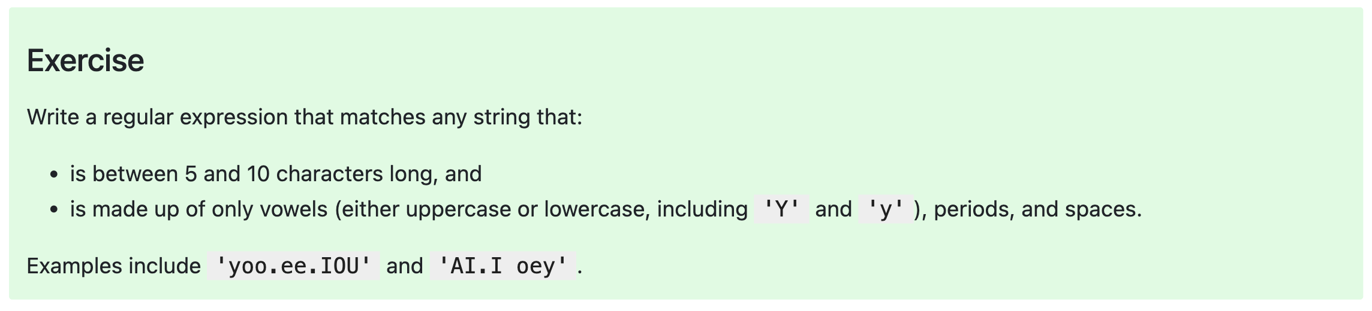
Try It! ☺

